Slide 1
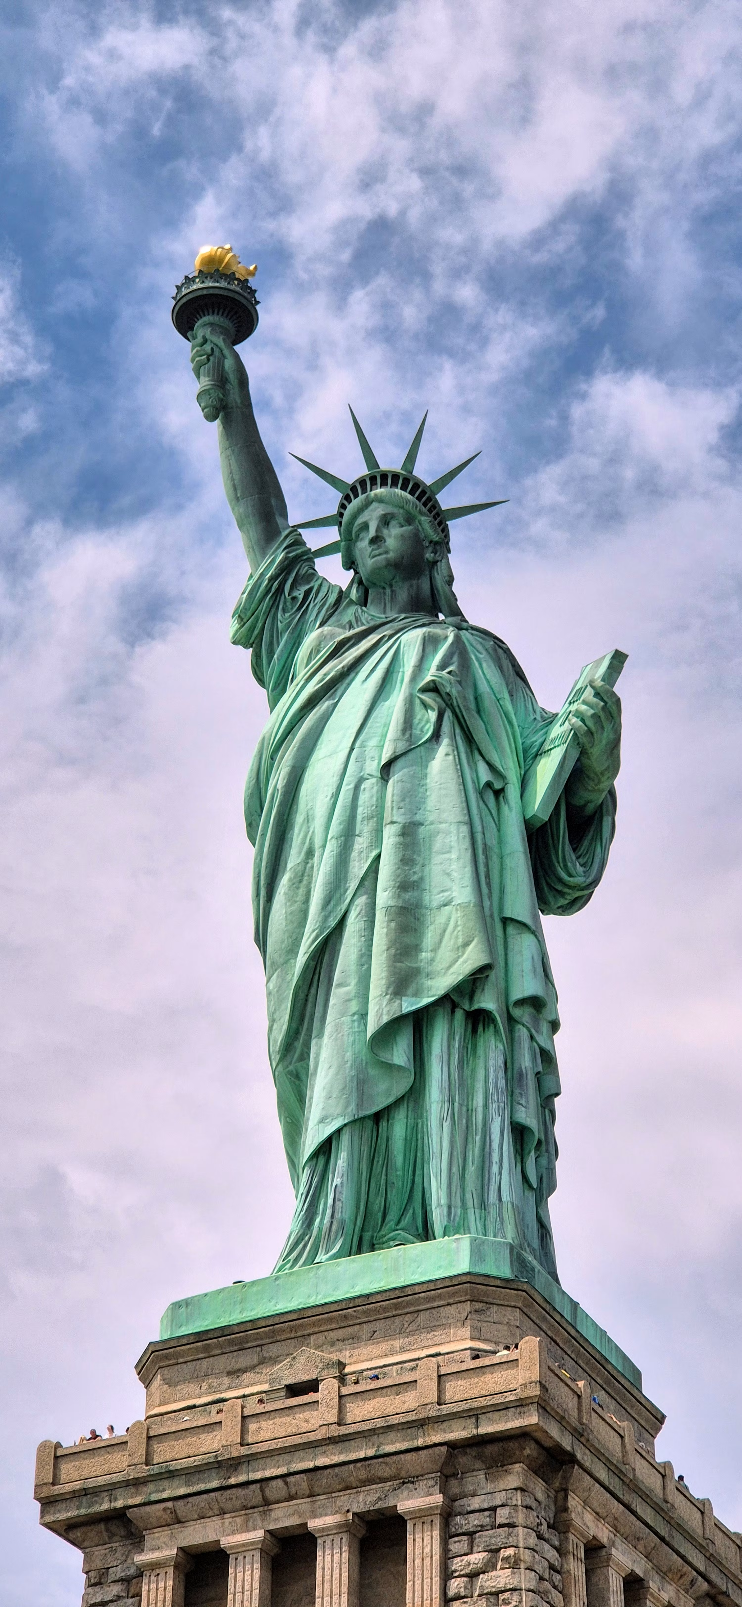
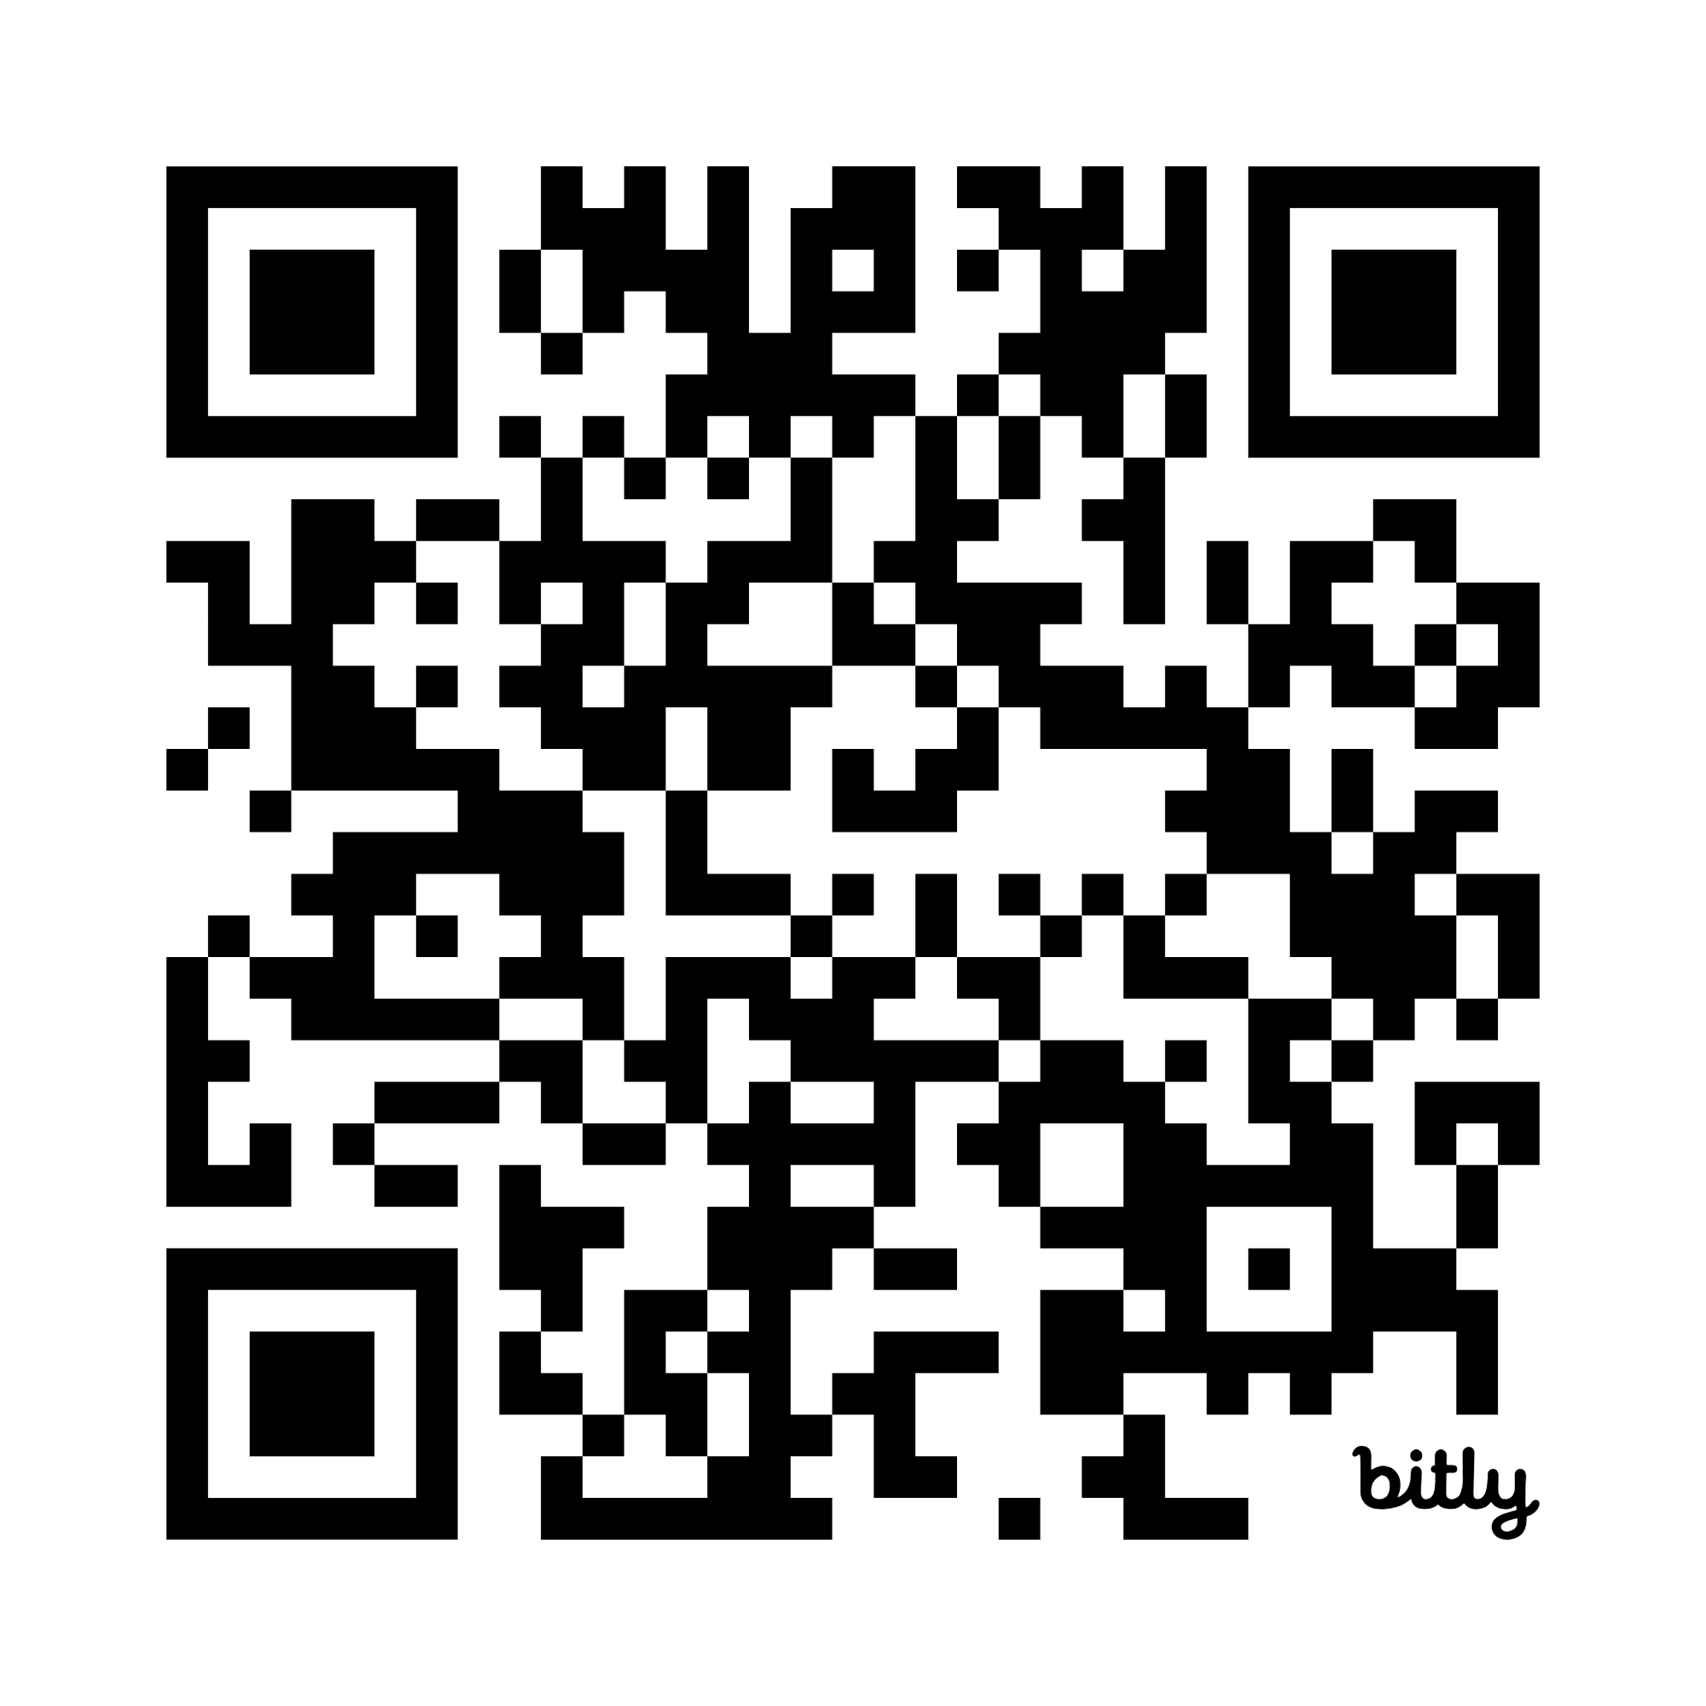
Foundations of American Culture
Department of History and Political Science
Our Dualistic Tradition
From the beginning, American culture has had two competing models vying for influence over our national life. In this presentation, we examine the nature of our dualistic legacy and how it has been manifested throughout American history. And we will consider the prospects for our cultural future in America.
A Lecture by Prof. Andrew Krieger
November 2026
04
Please RSVP Here
Wednesday, 1:30pm-3:00pm
TC 136

